Slide 1
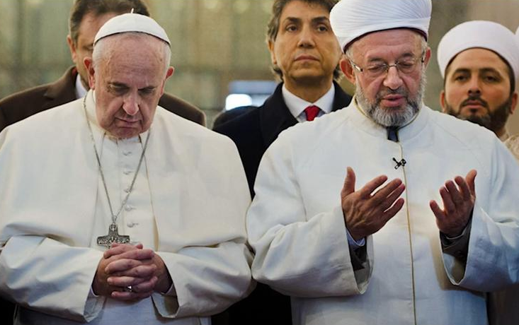
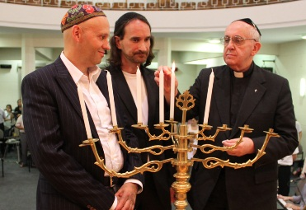

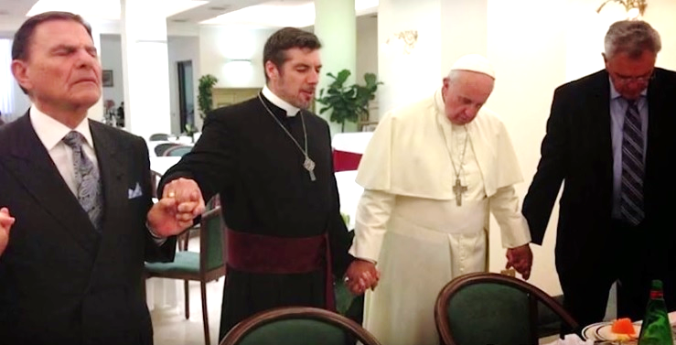
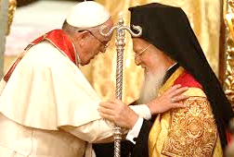
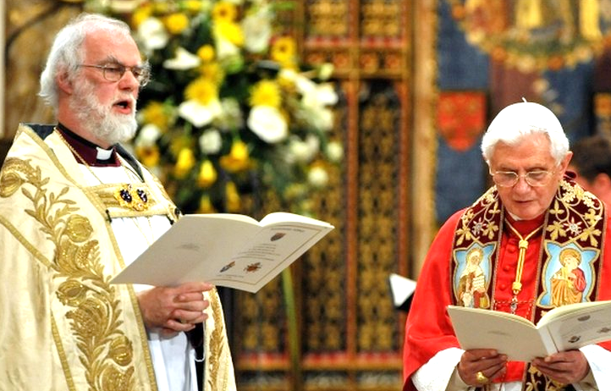
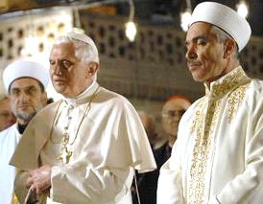
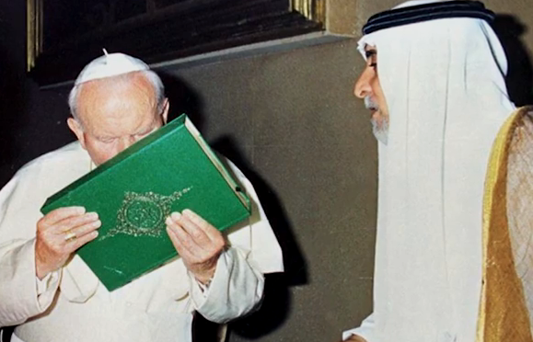
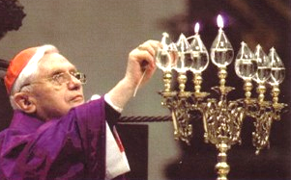
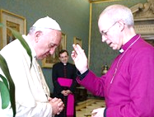
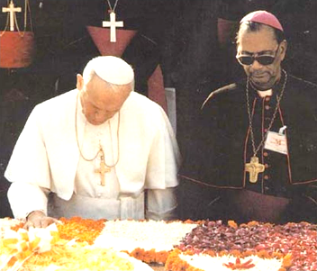
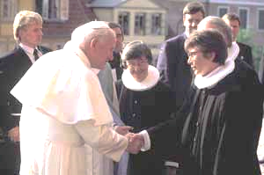
The vatican-2 cult apostasy ... goes on and on ... all the while claiming to be the Catholic Church ... from inside buildings with Catholic signs
More photos > Sections 12.6.1, 12.6.2, 12.7.1, 12.7.2, 12.10.1, 13, 13.1
In 1914 ... the Papacy fell vacant as a result of heresy (lying against Dogma) > Section 20
In 1965 ... the Catholic Church loses all its physical properties by heresy > Sections 12, 13
*
Virtually everyone has been eased into a heretic state, encouraged to stay heretic, and encouraged to be apostates ... states where you cannot get to Heaven
*
Download
this
booklet:
Appendix A-1
(of the site)
Item 3
www.Gods-Catholic-Dogma.com
Bergoglio (a.k.a. “Francis”) working for the damnation of un-baptized persons
confirming “muslims” in their error
Bergoglio (a.k.a. “Francis”) working for the damnation of un-baptized persons, confirming “jews” in their error
www.Gods-Christian-Dogma.com
Please reference my site ... either URL (above) ... which contains
over 425 Sections and over 8,500 Citations ... proving that ...
1. The BIBLE says ... 15 TIMES it is not the authority on Faith ... the BIBLE says
the Church Dogma is the true definition of Christianity > Section 6 (see also 3.3)
2. The vatican-2 heretic cult (founded on 8 December 1965) ... cannot possibly be
the Catholic Church (founded by Christ in 33 A.D.) > Sections 12, 12.1.3 and 13
3. No one can get to Heaven in a heretic state or un-baptized > Sections 1, 2, 7, 7.2
4. Ignorance of the Dogma is not a “loophole” ... to Heaven > Sections 5.1, 5.1.1, 58
5. Dogma on Automatic Excommunication for heresy > Sections 13.2 and 13.2.2
6. Dogma that the “Gates of Hell” scripture is not about the Papacy > Section 13.3
7. Remedy ... Formal Abjuration of heresy to become Christian > Section 19.1
Bergoglio working for the damnation
of “evangelical” heretics, confirming
them in their soul damning error
The group names in this booklet ... are in “quotes” because they have ... no merit before God
Bergoglio working for the damnation of
“eastern rite” heretics ... confirming them in their soul damning error
*
And much more ...
Ratzinger working for the damnation of “anglican” heretics. Rowan was former
cult leader of the “church of England”
Ratzinger (a.k.a. “Benedict XVI”)
working for the damnation of “muslims”
confirming them in their error
(Left) Wojtyla (a.k.a. “John Paul II”) kissing the “koran” ... (Ctr) Ratzinger (a.k.a. “Benedict XVI”)
lighting a menorah ... (Right) Bergoglio (a.k.a. “Francis”) with “church of England” heretic Welby
Catholic_Dogma_Providers@mail.com
Much more photo proof of vatican-2 cult heresy and apostasy ... Sections 12.6.1, 12.6.2, 12.7.1, 12.7.2, 12.10.1, 13, and 13.1 ... working to send people into Hell, confirming them in their errors.
Catholic writing of Saint Paul in Titus 3:10 >
“A man that is a heretic ... sinneth, being condemned by his own judgment.”
Council of Florence, Session 8, 22 Nov 1439 -- Ex-Cathedra Dogma >
“Whoever wills to be saved, before all things it is necessary that he holds the Catholic
faith. Unless a person keeps this faith ... without doubt he shall perish eternally.”
Wojtyla (a.k.a. “John Paul II”) at the grave of Gandhi ... working for the damnation of “hindus”
Wojtyla working for the damnation of “lutheran” heretics, confirming them
in their soul damning error
Email: Catholic_Dogma_Providers@mail.com
- 28 of 28 -
- 1 of 28 -

Slide 2
To understand the supernatural Order
(that which pertains to Heaven and Hell, good and evil) ...
one must understand Original Sin ...
The continuity ... of the Catholic Church. List of Popes ... the Papacy fell
vacant by heresy in 1914. Proofs on Sections 12, 20, 20.1, 20.2
1. St. Peter (33-67)
2. St. Linus (67-76)
3. St. Anacletus (76-88)
4. St. Clement I (88-97)
5. St. Evaristus (97-105)
6. St. Alexander I (105-115)
7. St. Sixtus I (115-125)
8. St. Telesphorus (125-136)
9. St. Hyginus (136-140)
10. St. Pius I (140-155)
11. St. Anicetus (155-166)
12. St. Soter (166-175)
13. St. Eleutherius (175-189)
14. St. Victor I (189-199)
15. St. Zephyrinus (199-217)
16. St. Callistus I (217-22)
17. St. Urban I (222-30)
18. St. Pontain (230-35)
19. St. Anterus (235-36)
20. St. Fabian (236-50)
21. St. Cornelius (251-53)
22. St. Lucius I (253-54)
23. St. Stephen I (254-257)
24. St. Sixtus II (257-258)
25. St. Dionysius (260-268)
26. St. Felix I (269-274)
27. St. Eutychian (275-283)
28. St. Caius (283-296)
29. St. Marcellinus (296-304)
30. St. Marcellus I (308-309)
31. St. Eusebius (309 or 310)
32. St. Miltiades (311-14)
33. St. Sylvester I (314-35)
34. St. Marcus (336)
35. St. Julius I (337-52)
36. Liberius (352-66)
37. St. Damasus I (366-83)
38. St. Siricius (384-99)
39. St. Anastasius I (399-401)
40. St. Innocent I (401-17)
41. St. Zosimus (417-18)
42. St. Boniface I (418-22)
43. St. Celestine I (422-32)
44. St. Sixtus III (432-40)
45. St. Leo I (440-61)
46. St. Hilarius (461-68)
47. St. Simplicius (468-83)
48. St. Felix III (II) (483-92)
49. St. Gelasius I (492-96)
50. Anastasius II (496-98)
51. St. Symmachus (498-514)
52. St. Hormisdas (514-23)
53. St. John I (523-26)
54. St. Felix IV (III) (526-30)
55. Boniface II (530-32)
56. John II (533-35)
57. St. Agapetus I (535-36)
58. St. Silverius (536-37)
59. Vigilius (537-55)
60. Pelagius I (556-61)
61. John III (561-74)
62. Benedict I (575-79)
63. Pelagius II (579-90)
64. St. Gregory I (590-604)
65. Sabinian (604-606)
66. Boniface III (607)
67. St. Boniface IV (608-15)
68. St. Deusdedit (615-18)
69. Boniface V (619-25)
70. “Honorius I” - fell into
heresy see Constantinople III
71. Severinus (640)
72. John IV (640-42)
73. Theodore I (642-49)
74. St. Martin I (649-55)
75. St. Eugene I (655-57)
76. St. Vitalian (657-72)
77. Adeodatus (II) (672-76)
78. Donus (676-78)
79. St. Agatho (678-81)
80. St. Leo II (682-83)
81. St. Benedict II (684-85)
82. John V (685-86)
83. Conon (686-87)
84. St. Sergius I (687-701)
85. John VI (701-05)
86. John VII (705-07)
87. Sisinnius (708)
88. Constantine (708-15)
89. St. Gregory II (715-31)
90. St. Gregory III (731-41)
91. St. Zachary (741-52)
92. Stephen II (752)
93. Stephen III (752-57)
94. St. Paul I (757-67)
95. Stephen IV (767-72)
96. Adrian I (772-95)
97. St. Leo III (795-816)
98. Stephen V (816-17)
99. St. Paschal I (817-24)
100. Eugene II (824-27)
101. Valentine (827)
102. Gregory IV (827-44)
103. Sergius II (844-47)
104. St. Leo IV (847-55)
105. Benedict III (855-58)
106. St. Nicholas I (858-67)
107. Adrian II (867-72)
108. John VIII (872-82)
109. Marinus I (882-84)
110. St. Adrian III (884-85)
111. Stephen VI (885-91)
112. Formosus (891-96)
113. Boniface VI (896)
114. Stephen VII (896-97)
115. Romanus (897)
116. Theodore II (897)
117. John IX (898-900)
118. Benedict IV (900-03)
119. Leo V (903)
120. Sergius III (904-11)
121. Anastasius III (911-13)
122. Lando (913-14)
123. John X (914-28)
124. Leo VI (928)
125. Stephen VIII (929-31)
126. John XI (931-35)
127. Leo VII (936-39)
128. Stephen IX (939-42)
129. Marinus II (942-46)
130. Agapetus II (946-55)
131. John XII (955-63)
132. Leo VIII (963-64)
133. Benedict V (964)
134. John XIII (965-72)
135. Benedict VI (973-74)
136. Benedict VII (974-83)
137. John XIV (983-84)
138. John XV (985-96)
139. Gregory V (996-99)
140. Sylvester II (999-1003)
141. John XVII (1003)
142. John XVIII (1003-09)
143. Sergius IV (1009-12)
144. Benedict VIII (1012-24)
145. John XIX (1024-32)
146. Benedict IX (1032-45)
Appears three times,
he was restored twice.
147. Sylvester III (1045)
148. Benedict IX (1045)
149. Gregory VI (1045-46)
150. Clement II (1046-47)
151. Benedict IX (1047-1048)
152. Damasus II (1048)
153. St. Leo IX (1049-54)
154. Victor II (1055-57)
155. Stephen X (1057-58)
156. Nicholas II (1058-61)
157. Alexander II (1061-73)
158. St. Gregory VII (1073-85)
159. Bl. Victor III (1086-87)
160. Bl. Urban II (1088-99)
161. Paschal II (1099-1118)
162. Gelasius II (1118-19)
163. Callistus II (1119-24)
164. Honorius II (1124-30)
165. Innocent II (1130-43)
166. Celestine II (1143-44)
167. Lucius II (1144-45)
168. Bl. Eugene III (1145-53)
169. Anastasius IV (1153-54)
170. Adrian IV (1154-59)
171. Alexander III (1159-81)
172. Lucius III (1181-85)
173. Urban III (1185-87)
174. Gregory VIII (1187)
175. Clement III (1187-91)
176. Celestine III (1191-98)
177. Innocent III (1198-1216)
178. Honorius III (1216-27)
179. Gregory IX (1227-41)
180. Celestine IV (1241)
181. Innocent IV (1243-54)
182. Alexander IV (1254-61)
183. Urban IV (1261-64)
184. Clement IV (1265-68)
185. Bl. Gregory X (1271-76)
186. Bl. Innocent V (1276)
187. Adrian V (1276)
188. John XXI (1276-77)
189. Nicholas III (1277-80)
190. Martin IV (1281-85)
191. Honorius IV (1285-87)
192. Nicholas IV (1288-92)
193. St. Celestine V (1294)
194. Boniface VIII (1294-1303)
195. Bl. Benedict XI (1303-04)
196. Clement V (1305-14)
197. John XXII (1316-34)
198. Benedict XII (1334-42)
199. Clement VI (1342-52)
200. Innocent VI (1352-62)
201. Blessed Urban V (1362-70)
202. Gregory XI (1370-78)
203. Urban VI (1378-89)
204. Boniface IX (1389-1404)
205. Innocent VII (1404-06)
206. Gregory XII (1406-15)
207. Martin V (1417-31)
208. Eugene IV (1431-47)
209. Nicholas V (1447-55)
210. Callistus III (1455-58)
211. Pius II (1458-64)
212. Paul II (1464-71)
213. Sixtus IV (1471-84)
214. Innocent VIII (1484-92)
215. Alexander VI (1492-1503)
216. Pius III (1503)
217. Julius II (1503-13)
218. Leo X (1513-21)
219. Adrian VI (1522-23)
220. Clement VII (1523-34)
221. Paul III (1534-49)
222. Julius III (1550-55)
223. Marcellus II (1555)
224. Paul IV (1555-59)
225. Pius IV (1559-65)
226. St. Pius V (1566-72)
227. Gregory XIII (1572-85)
228. Sixtus V (1585-90)
229. Urban VII (1590)
230. Gregory XIV (1590-91)
231. Innocent IX (1591)
232. Clement VIII (1592-1605)
233. Leo XI (1605)
234. Paul V (1605-21)
235. Gregory XV (1621-23)
236. Urban VIII (1623-44)
237. Innocent X (1644-55)
238. Alexander VII (1655-67)
239. Clement IX (1667-69)
240. Clement X (1670-76)
241. Bl. Innocent XI (1676-89)
242. Alexander VIII (1689-91)
243. Innocent XII (1691-1700)
244. Clement XI (1700-21)
245. Innocent XIII (1721-24)
246. Benedict XIII (1724-30)
247. Clement XII (1730-40)
248. Benedict XIV (1740-58)
249. Clement XIII (1758-69)
250. Clement XIV (1769-74)
251. Pius VI (1775-99)
252. Pius VII (1800-23)
253. Leo XII (1823-29)
254. Pius VIII (1829-30)
255. Gregory XVI (1831-46)
256. Pius IX (1846-78)
257. Leo XIII (1878-1903)
258. Pius X (1903-14)
Papacy falls vacant
because of heresy
- - - “Benedict XV” (1914-22)
- - - “Pius XI” (1922-39)
- - - “Pius XII” (1939-58)
- - - “John XXIII” (1958-63)
- - - “Paul VI” (1963-78)
- - - “John Paul I” (1978)
- - - “John Paul II” (1978-2005)
- - - “Benedict XVI” (2005-2013)
- - - “Francis” (2013 - )
1. Original Sin did close Heaven (temporarily) for all men (see citations below) ...
leaving Hell as the only possible destination for men’s souls.
2. Original Sin ... is generationally transmitted ... human souls are in the same shape
as the material body (Council of Vienne - Decree 1, Council of Florence - Session 8).
It is the soul that animates the material body.
3. Original Sin is the reason for death, disease, and the loss of integrity among men.
4. God re-opened Heaven in one prescribed way ... believing the Catholic Dogma
and being baptized in water to remit Original Sin. He did not re-open Heaven by the
man-made heresies or by the man-made groups of un-baptized persons.
~ ~ ~
Selected ... Original Sin Scriptures
Catholic Faith (pre-fulfillment) writing of Ecclesiastes 9:3 >
“This is a very great evil among all things that are done under the sun, that the
same things happen to all men ... they shall be brought down to Hell.”
Catholic Faith (pre-fulfillment) writing of Psalm 88:49 >
“Who is the man that shall live, and not see death: that shall deliver his soul
from the hand of Hell ?”
Catholic Faith (pre-fulfillment) writing of Isaias 5:14 >
“Hell enlarged her soul ... and their strong ones, and their people, and their high
and glorious ones shall go down into it.”
More > www.Gods-Catholic-Dogma.com > Sections: Introduction and 7.2
Note: During Old Testament times ... People descended into two different Sections of Hell ...
(1) Limbo (Abraham’s bosom) and (2) the Hell of the damned. The souls of the Old Testament
justified people went to Heaven after the Catholic Church was founded in 33 A.D. The manner by
which persons were justified in the Old Testament is on Section 138 of the site.
The vatican-2 heretic cult (founded in 1965) does not have the Office of the Papacy ... only God’s Catholic Church (founded in 33 A.D.) has the Papacy
~ ~ ~
To enter the Catholic Church ... which has no physical
properties in these times ... so that you will have some
possibility of getting to Heaven ... please proceed to
Sections 2.1 and 19.1 of > www.Gods-Catholic-Dogma.com
Catholic writing of Saint Peter 16:19 >
“And I (Jesus) will give to thee (Peter) the keys to the Kingdom of Heaven.” (Note: There is one set of Keys)
Catholic writing of Saint Peter 18:18 >
“Amen I (Jesus) say to you (Peter) whatsoever you (Peter) shall bind upon earth shall be bound also in Heaven.”
Council of Florence, Session 2, 15 February 1432 A.D. – Ex-Cathedra Dogma > (More > Section 3.3)
“For the expertation of heresies ... The Synod, assembled in the Holy Spirit, decrees,defines, declares as follows ...”
The infallible Sources of Dogma are still fully operative ... Even though the Office of the Papacy is vacant.
Phone > 772-205-8147 ~ E-mail > Catholic_Dogma_Providers@mail.com
- 2 of 28 -
- 27 of 28 -

